Slide 1
Bank Management System
By Muhammad Sajid Hameed Khan

Slide 2
To learn:
Creation of Data Base
Website Development
Connection of Data Base with the Website

Slide 3
Features in Bank
Bank is named as “Apna Spna Bank ( AS Bank )”.
Administration
Customer
News Posting
ATM (Automated Teller Machine)
Beneficiary
Passbook

Slide 4
Data Base
I created a data base ( “Bank_System” ) in SQL , which contains the table for different attributes like admin , customer etc.

Slide 5
Tools Used
In that project I familiarized myself with the use of following tools.
Phpmyadmin
Oracle
MySQL
Xampp
PHP Language ( Scripting language & also as programming language )
Html ( Hypertext markup language )

Slide 6
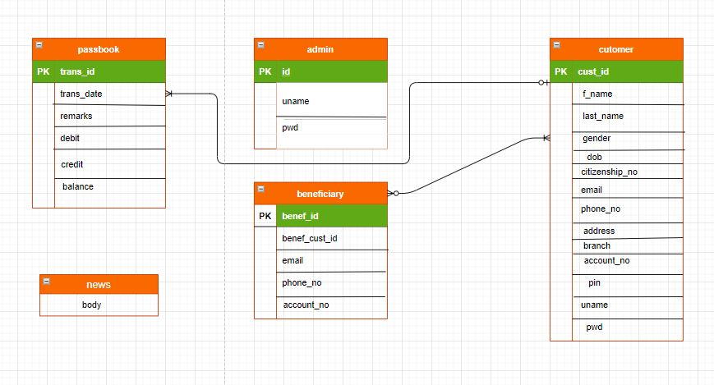
Schema of Database

Slide 7
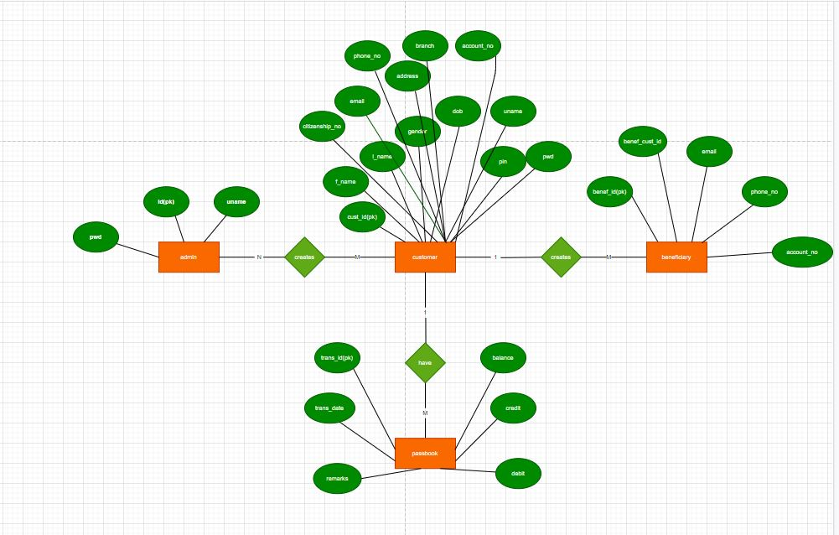
ER Diagram

Slide 8
Keep Smiling

